Slide 1
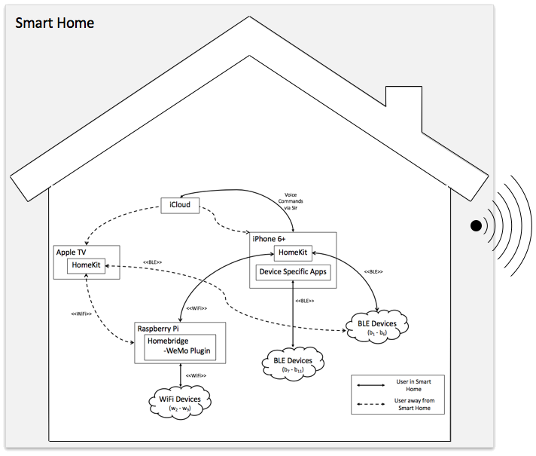

Slide 2
<<ISP>>
iCloud
<<ISP>>
Voice Commands
via Siri
<<LTE>>
Controller: iPhone 6+
Controller: Apple TV
HomeKit
HomeKit
<<BLE>>
Device Specific Apps
<<BLE>>
<<BLE>>
<<Wi-Fi>>
<<Wi-Fi>>
BLE Devices
(b₁ - b₆)
Controller: Raspberry Pi
Homebridge
-WeMo Plugin
BLE Devices
(b₇ - b₁₁)
<<WiFi>>
User in Smart Home
Wi-Fi Devices
(w₂ - w₉)
User away from Smart Home

Slide 3
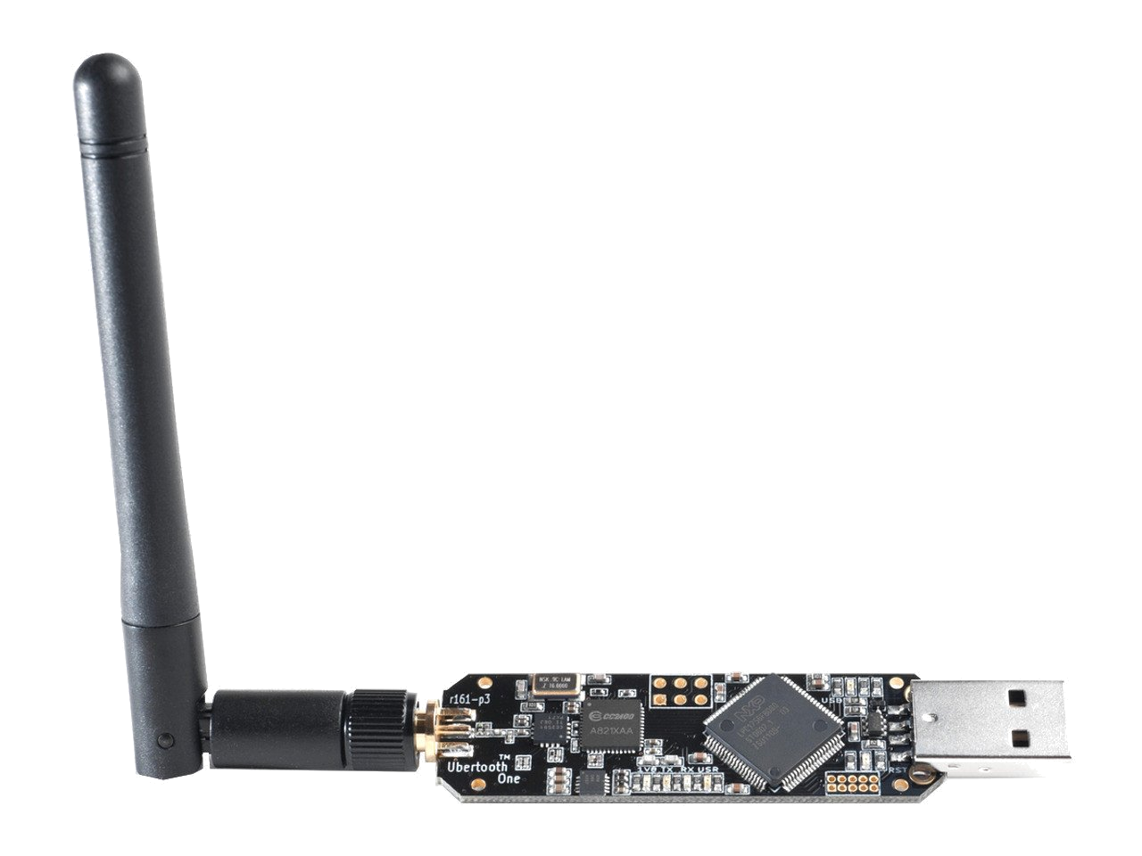
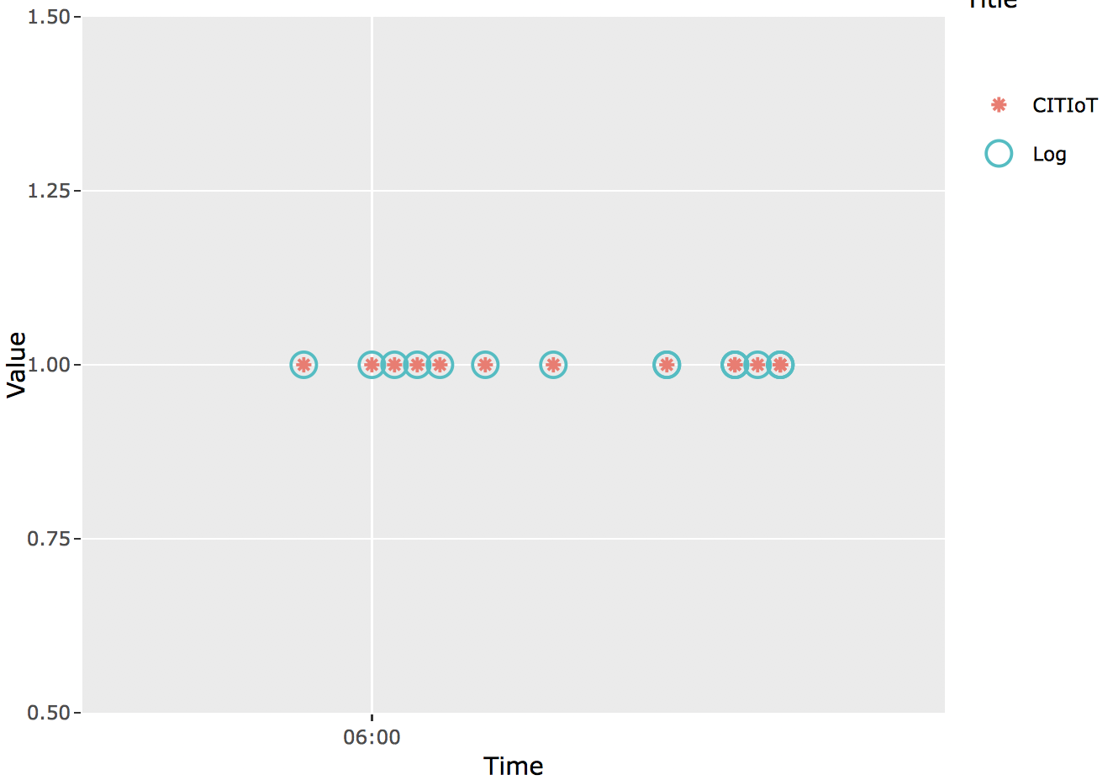

Homebridge
Logs
.csv
CITIoT
Passive
Sniffing
Device Classification,
Event ID,
User Tracking
Import,
Compare,
Visualize Data
BLE Devices
Plots
.pcap
.csv
WiFi Devices
Test Matrix
Logs
.csv
Notes:
3

Slide 4

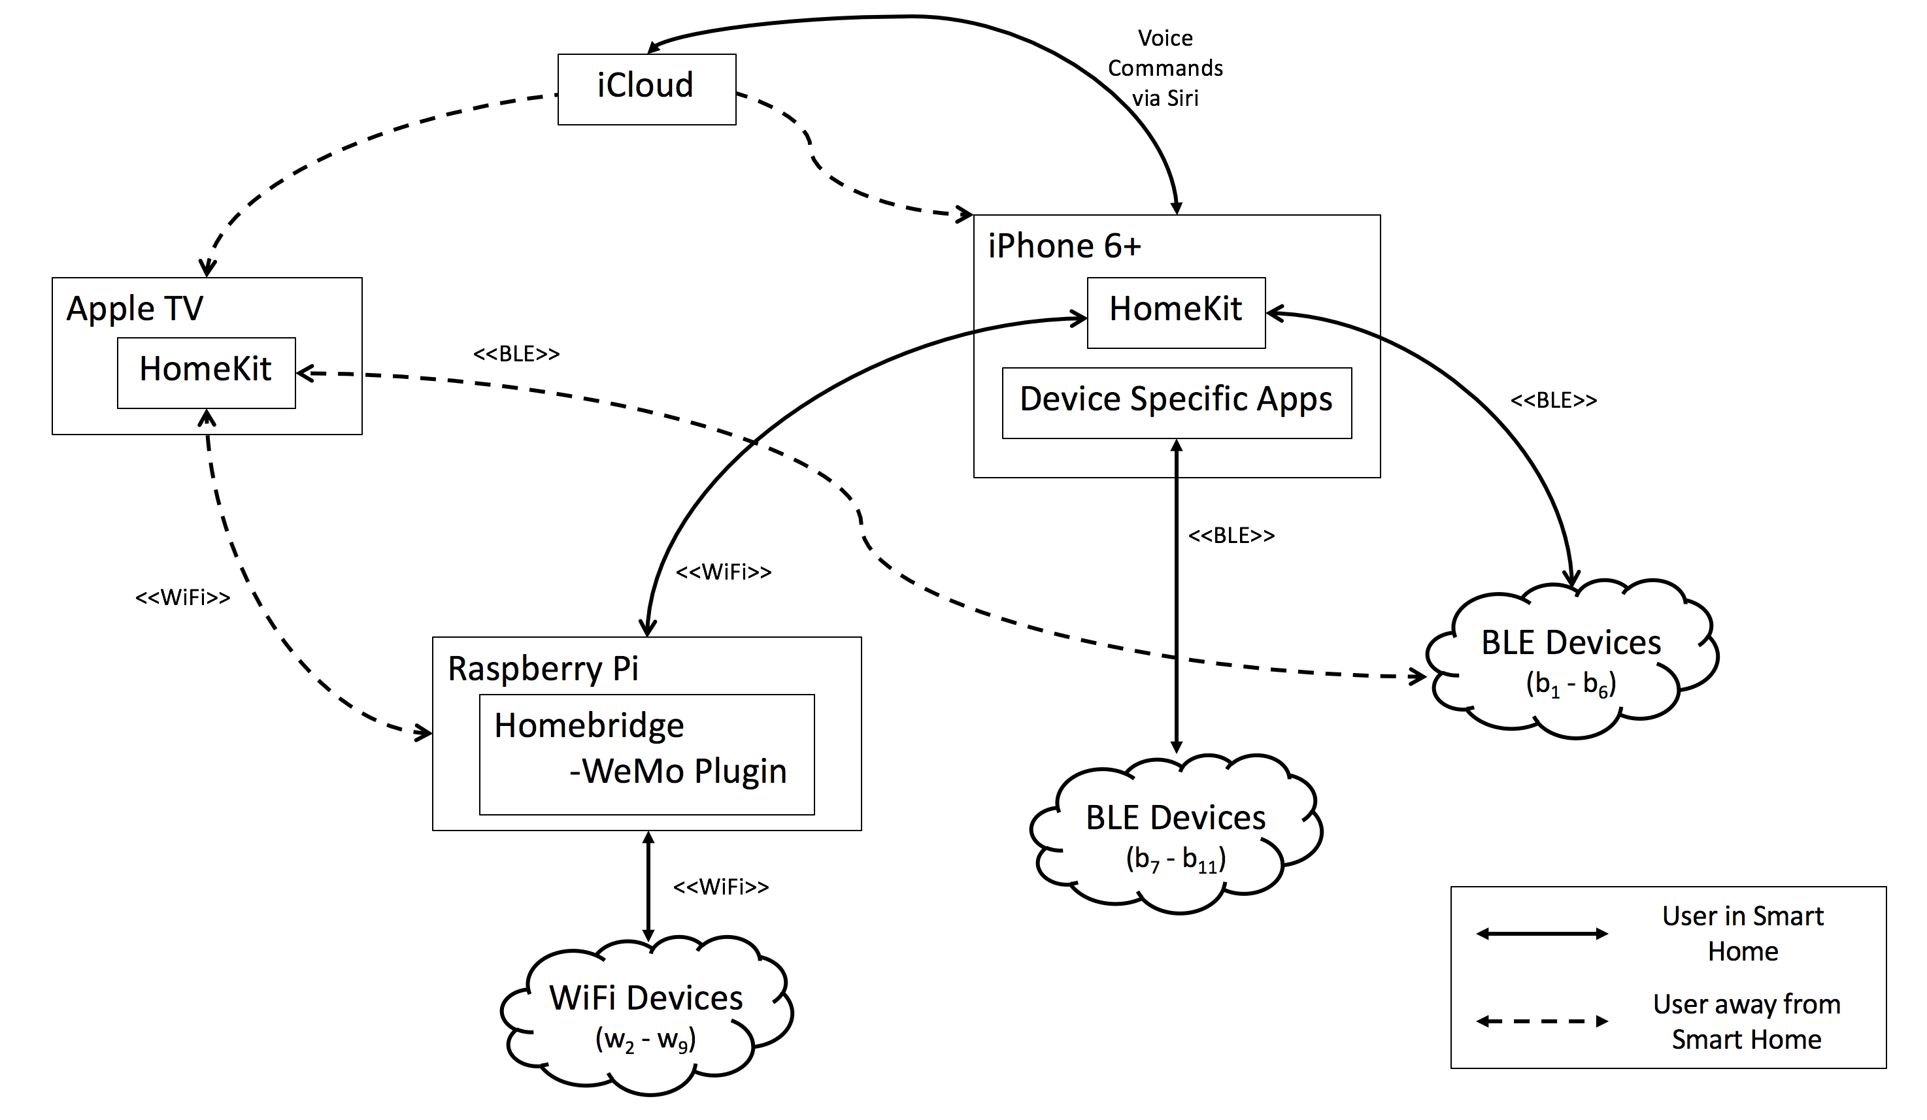
Smart Home
Host Machine

Slide 5
System Diagram
Smart Home
Host Machine
SHAA
CITIoT
MIoTL

Slide 6
MioTL Diagram
SHAA
MIoTL
Device Shadow
MAC
Shadow

Slide 7
Homebridge
Logs
.csv
CITIoT
Passive
Sniffing
Device Classification,
Event ID,
User Tracking
BLE Devices
Import,
Compare,
Visualize Data
.pcap
.csv
WiFi Devices
Test Matrix
Logs
.csv
Notes:
7

Slide 8
CITIoT
CSV Files
BLE pcap
BLE Device List
Classifier
BLE Event List
Target Info
Passive
Sniffing
CSV
files
Classifier
Network Mapper
Wi-Fi Device List
Recon
Wi-Fi Event List
Wi-Fi
pcap
Preprocessor
MAC Tracker
Wi-Fi Network Map
Wi-Fi Tracking List
BLE Devices
Sniffers
WiFi Devices
Notes:
8

Slide 9
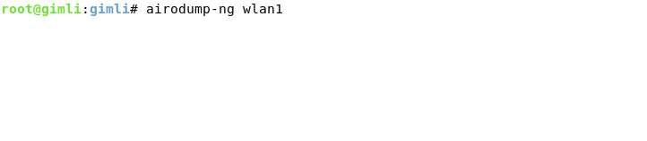
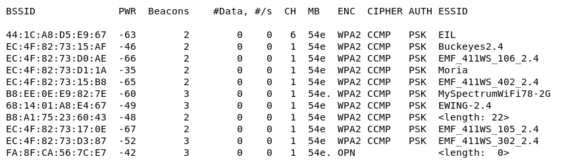
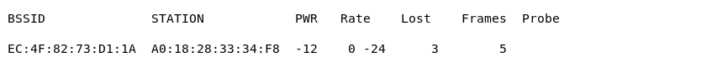

Slide 10
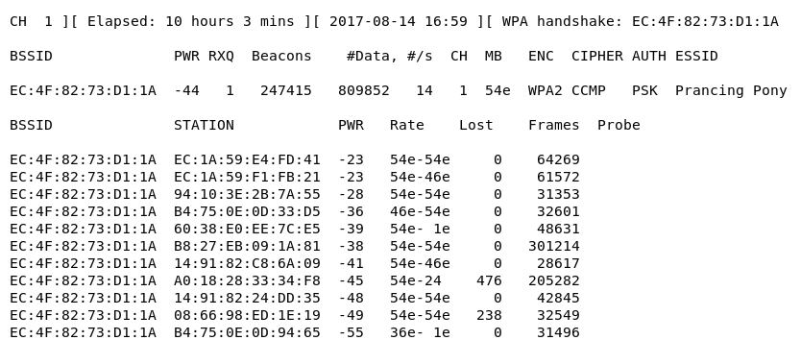

Slide 11
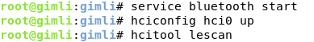
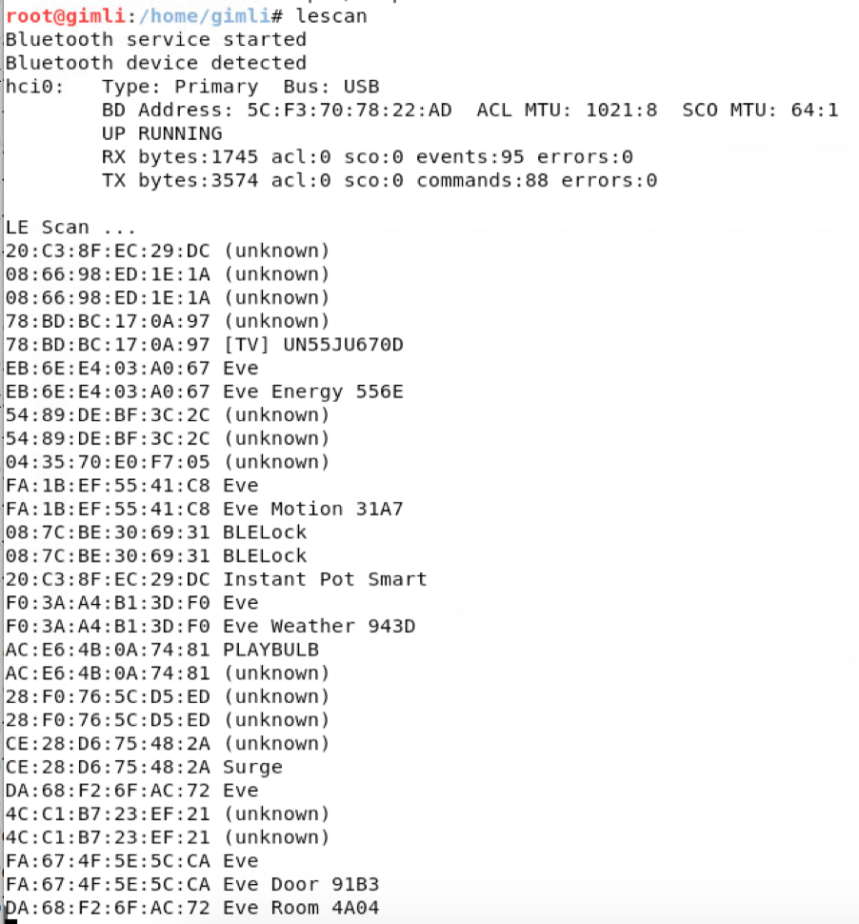

Slide 12
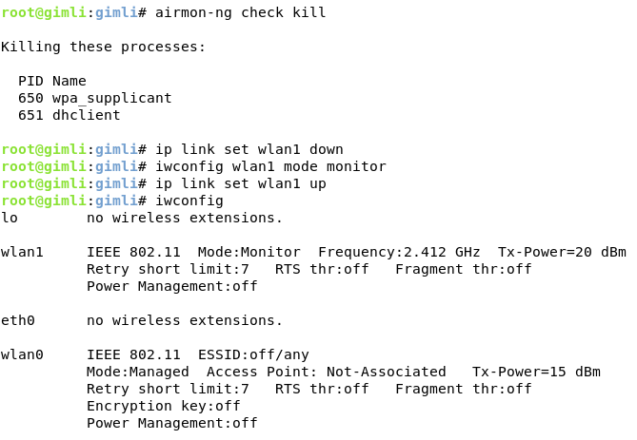
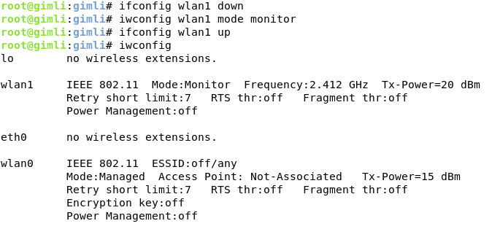

Slide 14
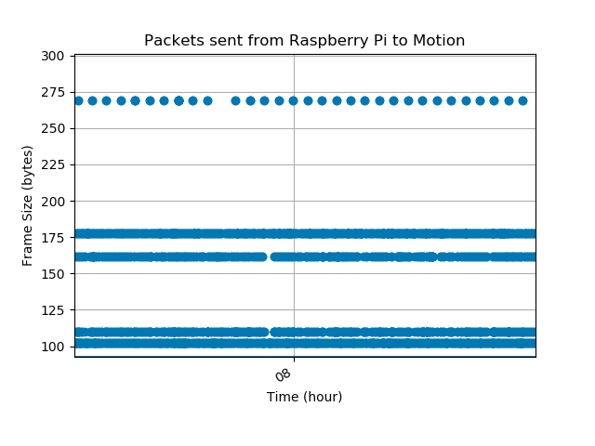
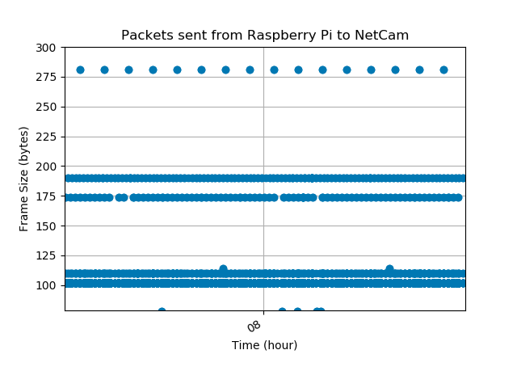
269 Bytes
281 Bytes

Slide 15
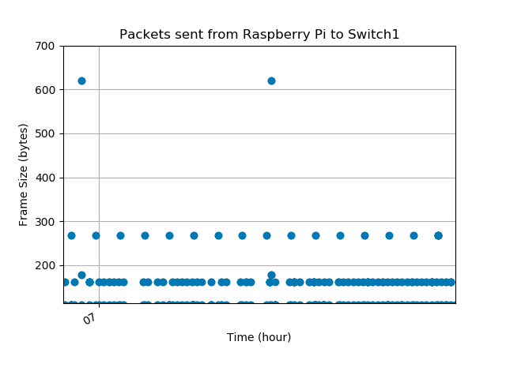
619-632 Bytes

Slide 16
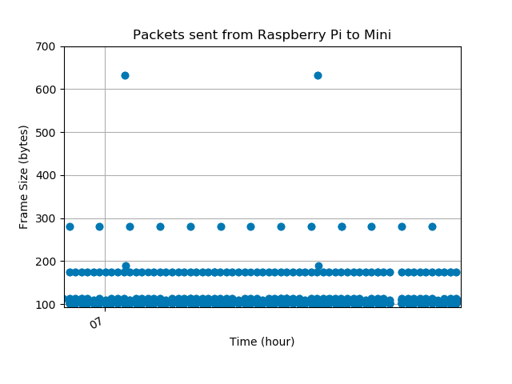
Events
619-632 Bytes

Slide 17
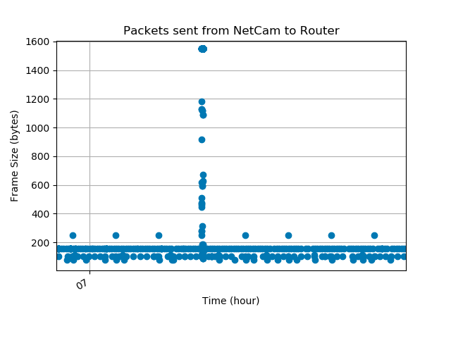
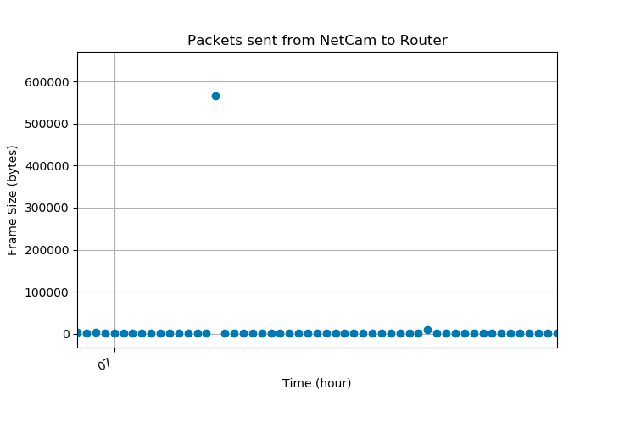
Event
Event
> 100,000 Bytes

Slide 18
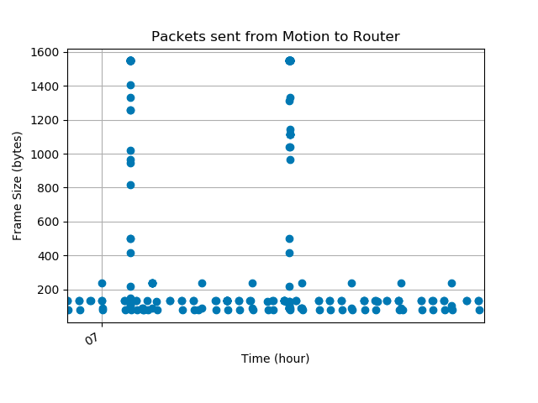
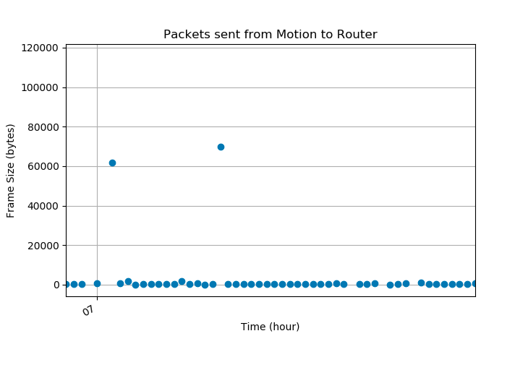
Events
Events
> 10,000 Bytes

Slide 19
Constant Factors
Device Types
# Devices
# Users
Sniffer Location
Device Location
Computing Param
Treatments
Uncontrolled Variables
System Under Test
(CITIoT)
Metrics
Smart Home
Device Classification
Components Under Test
Preprocessor
MAC Tracker
Classifier
Network Mapper
Event Identification
Events
SHAA
Wi-Fi Traffic
User Tracking
MIoTL Status
BLE Traffic
Processing Time
MIoTL
Hard Drive Usage

Slide 20
13 ft
Switch3
Eve Energy
Mini
Pi
Eve Weather
Motion
Playbulb
CITIoT
Switch1
Eve Room
Bike Lock
Steves-phone
11 ft
AppleTV
Gun Safe
Eve Motion
Switch4
Instant Pot
BioLock
Eve Door
Wi-Fi
NetCam
BLE
Switch2
Insight
Both
MIoTL
Not always in home
Moria

Slide 21
23 inches
20 inches
11 inches
11 inches

Slide 22
Frame Control
Duration/ID
Address 1
Address 2
Address 3
Sequence Control
Address 4
QoS Control
HT Control
Encrypted
MAC Header
IV/Key ID
Extended IV
Data (PDU)
MIC
ICV
FCS

Slide 23
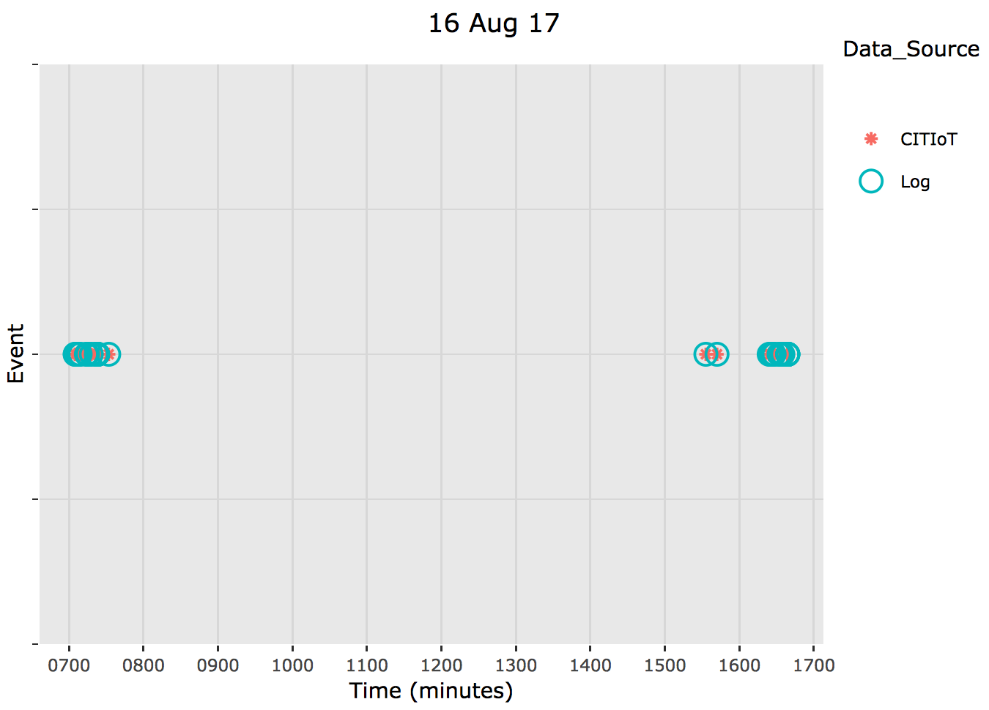
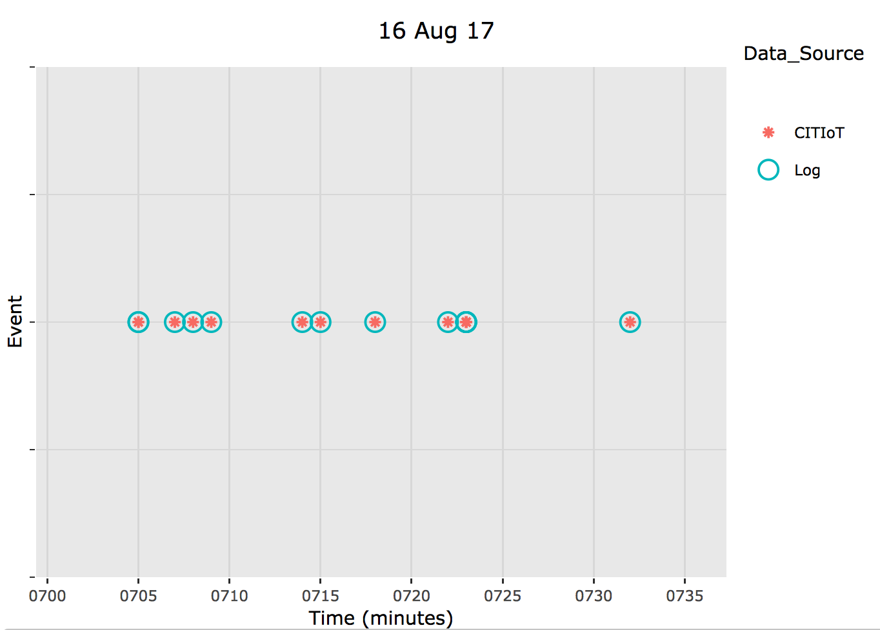

Slide 24
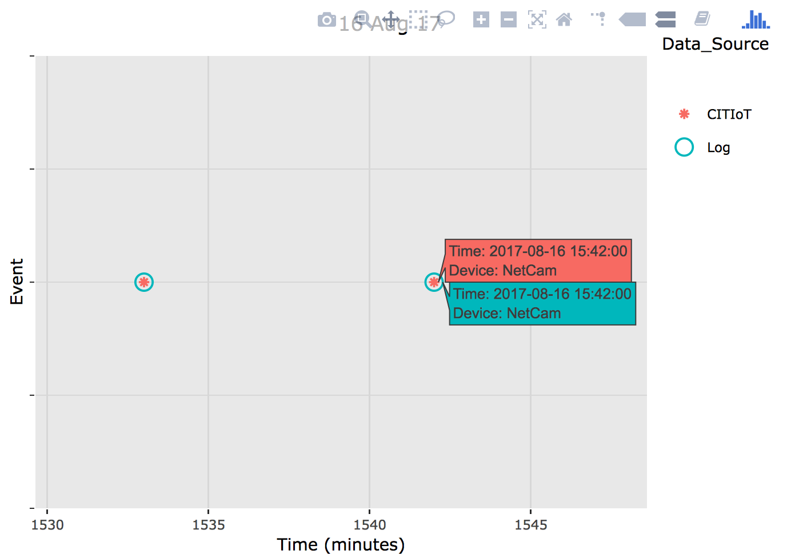
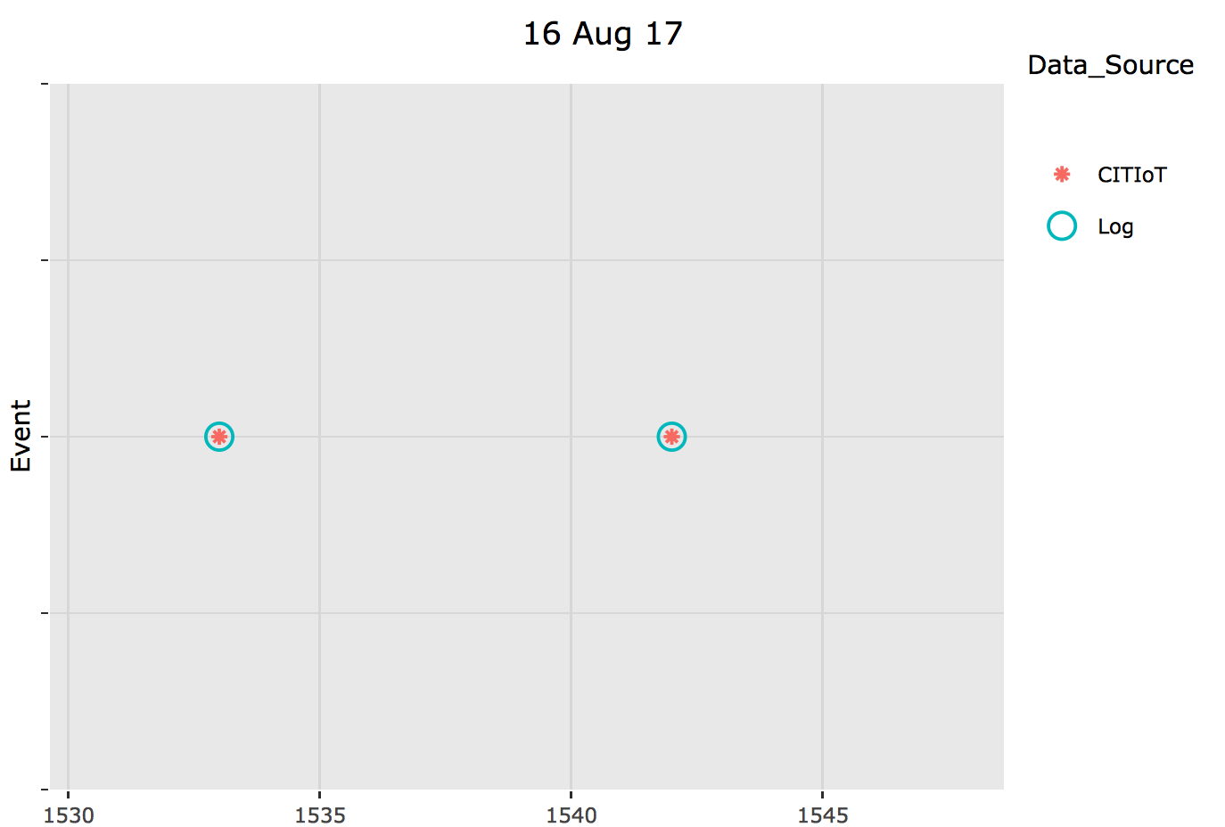
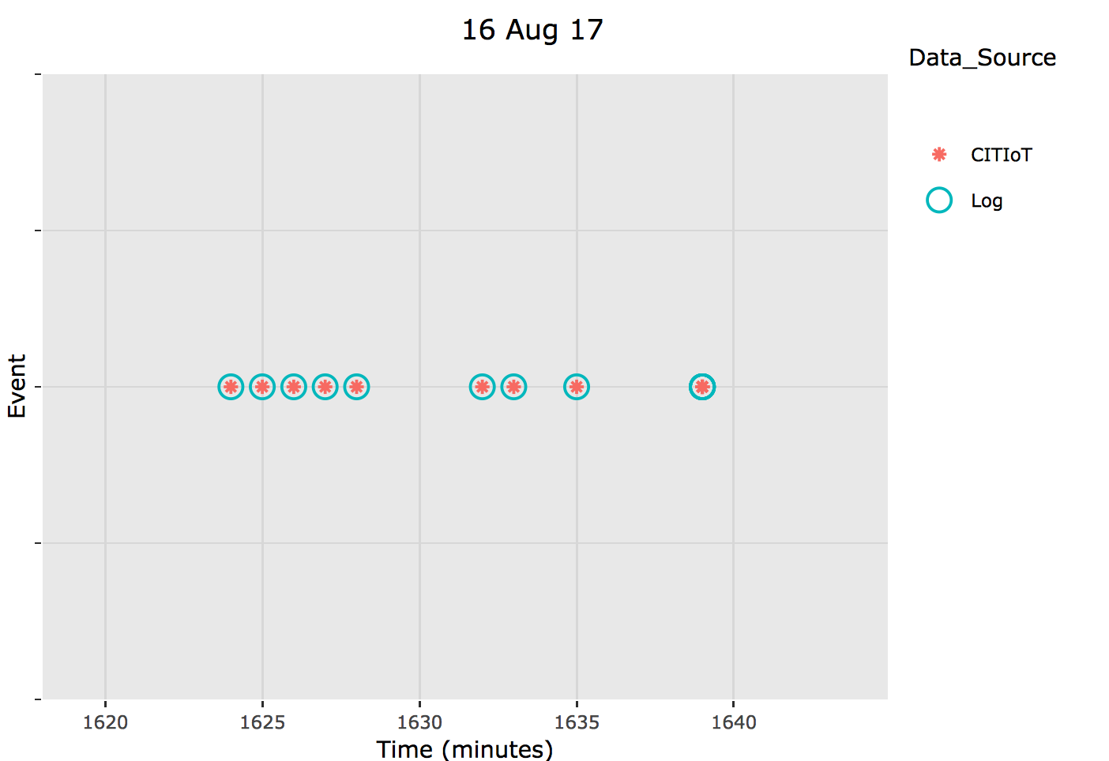

Slide 25
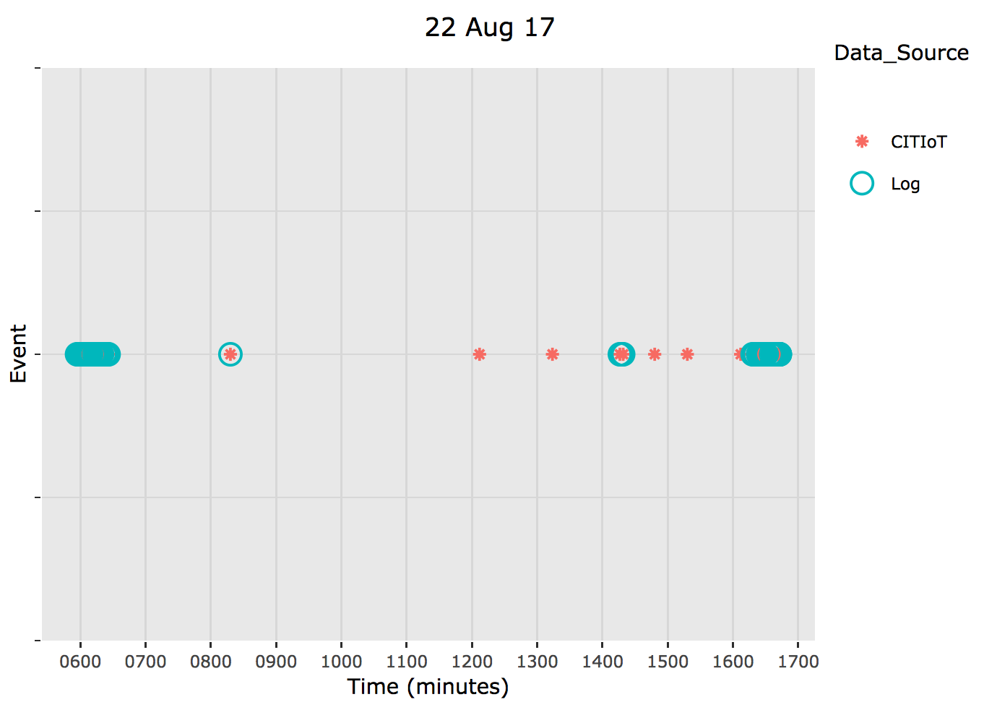
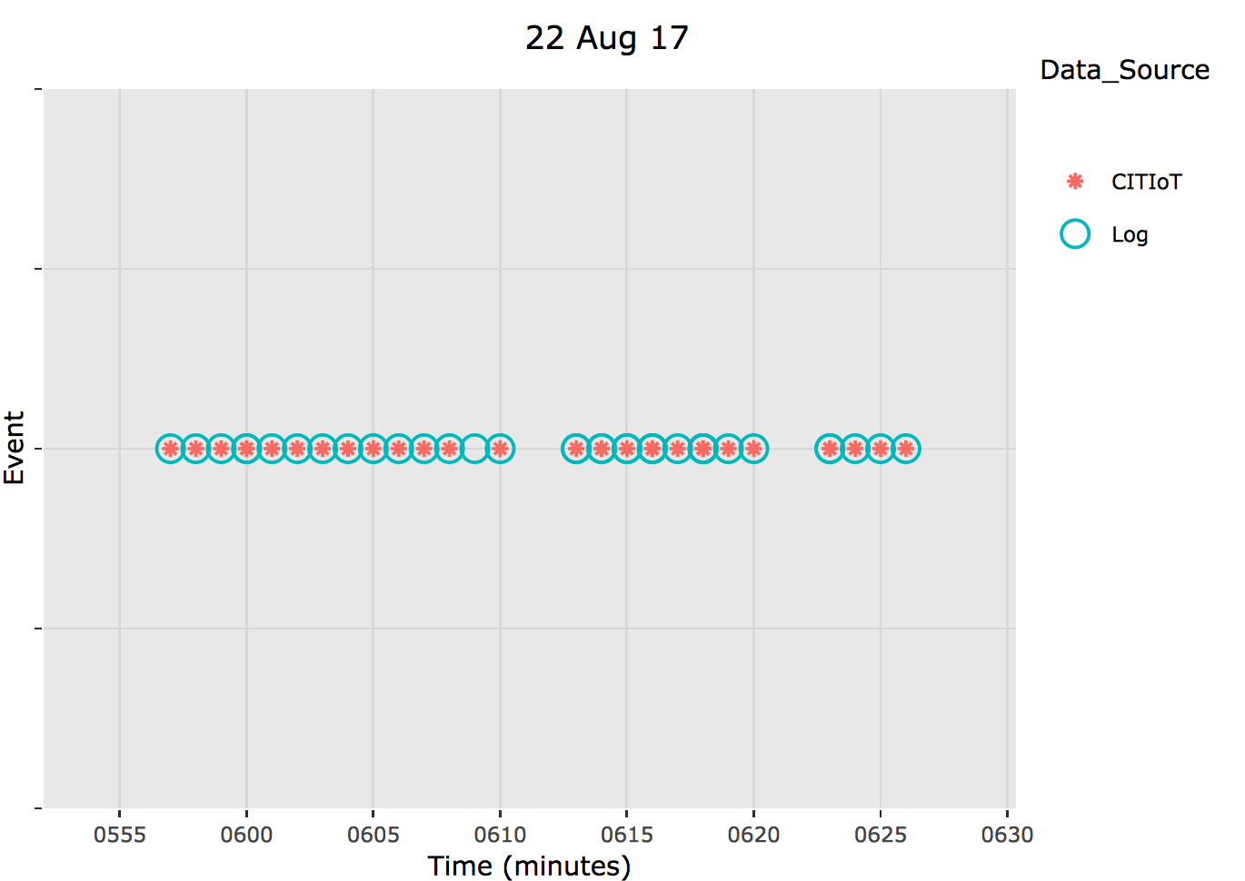

Slide 26
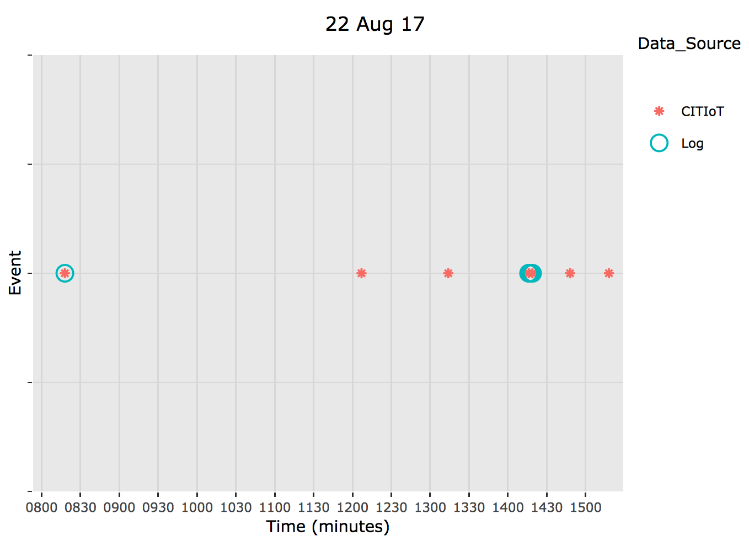
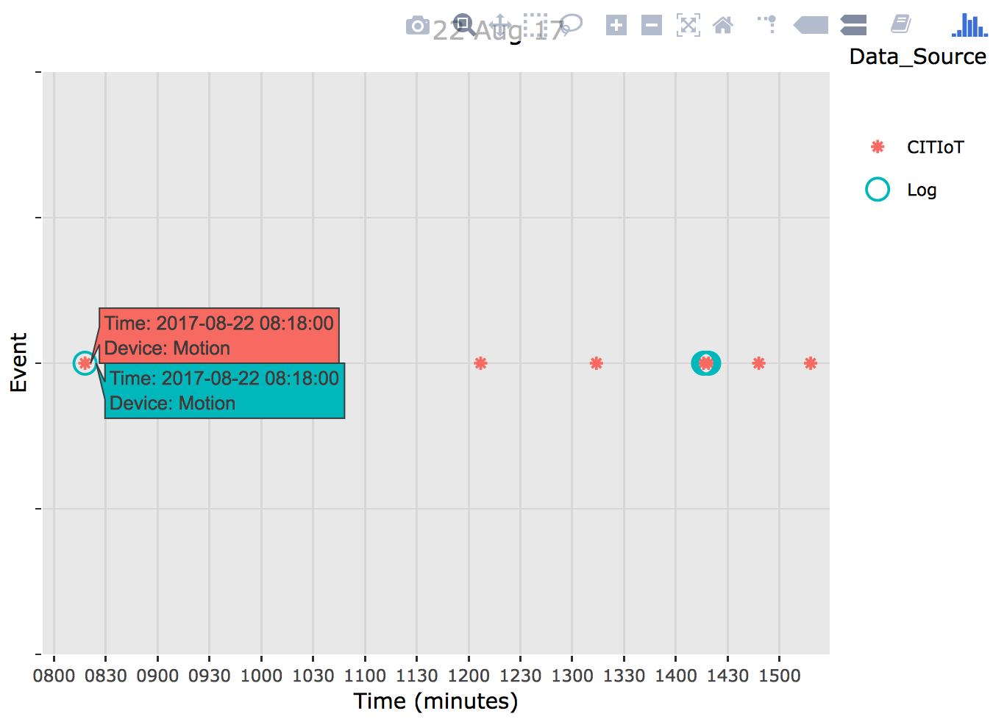
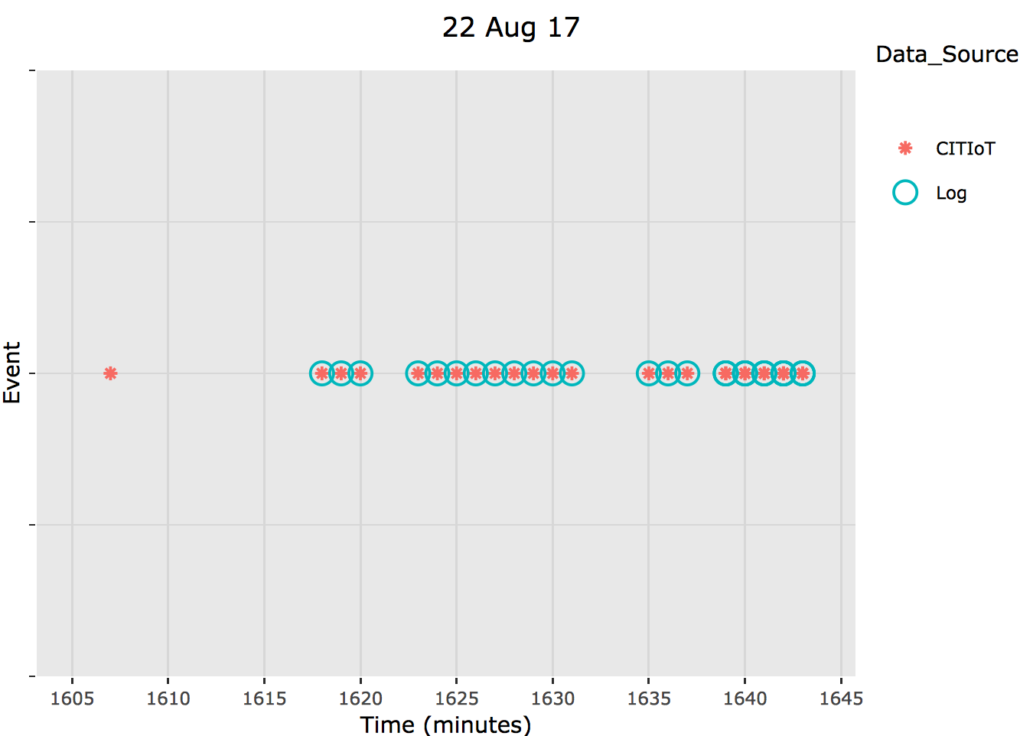

Slide 27
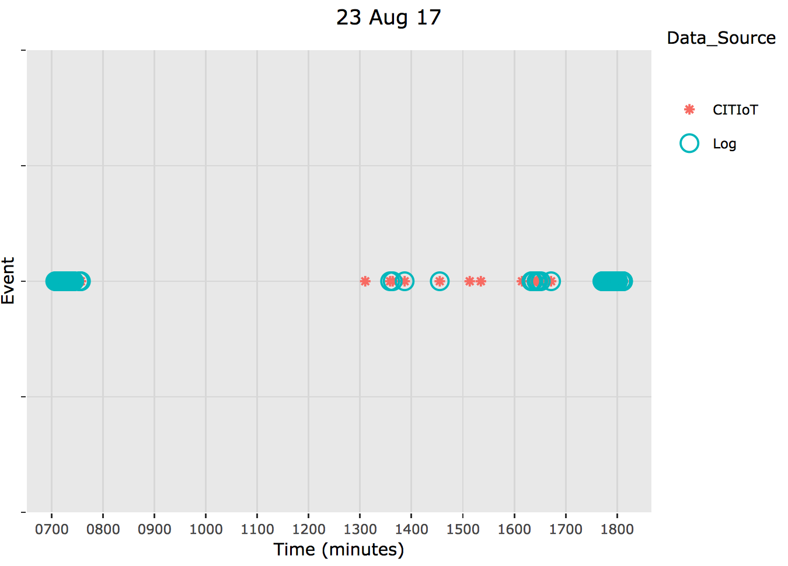
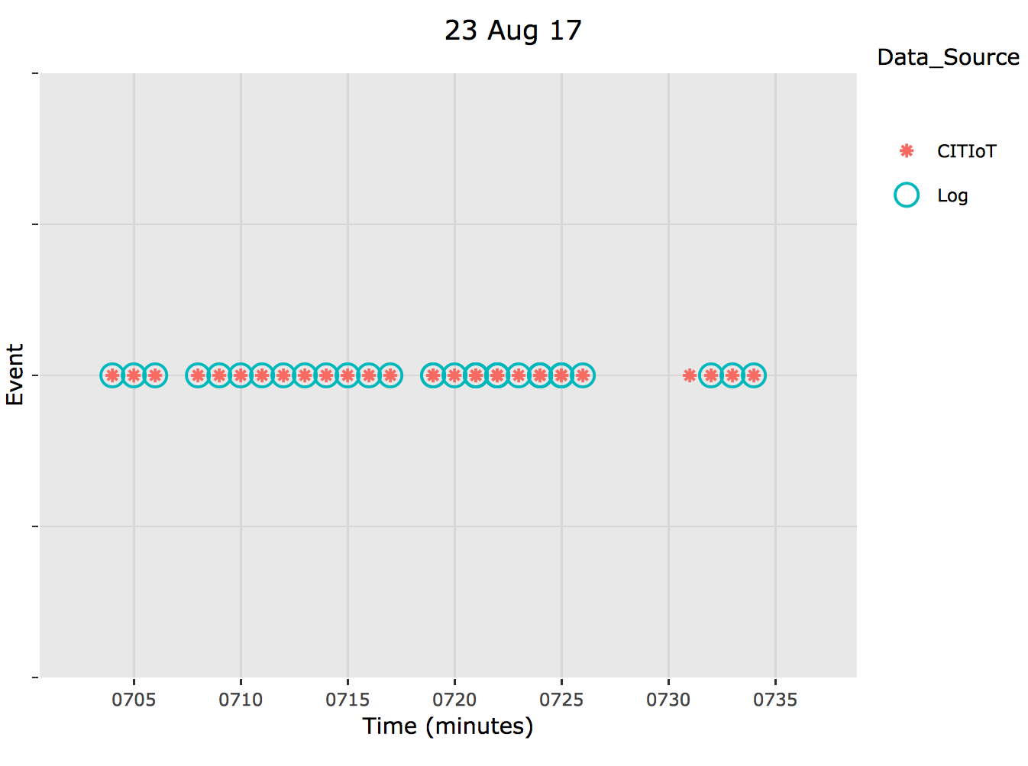

Slide 28
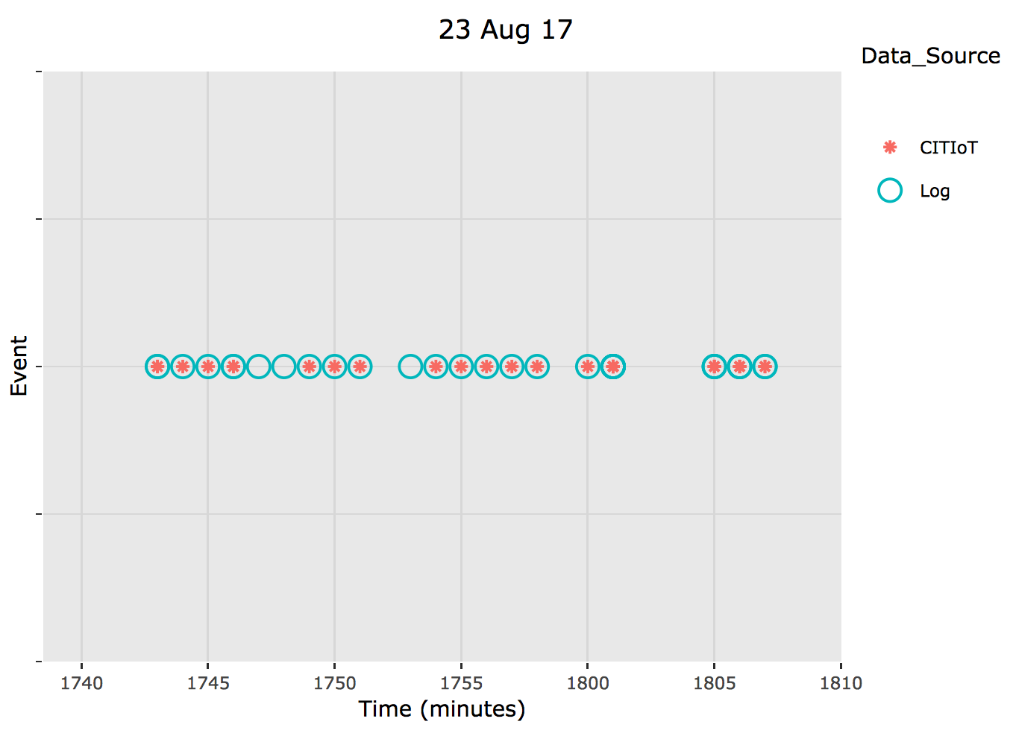
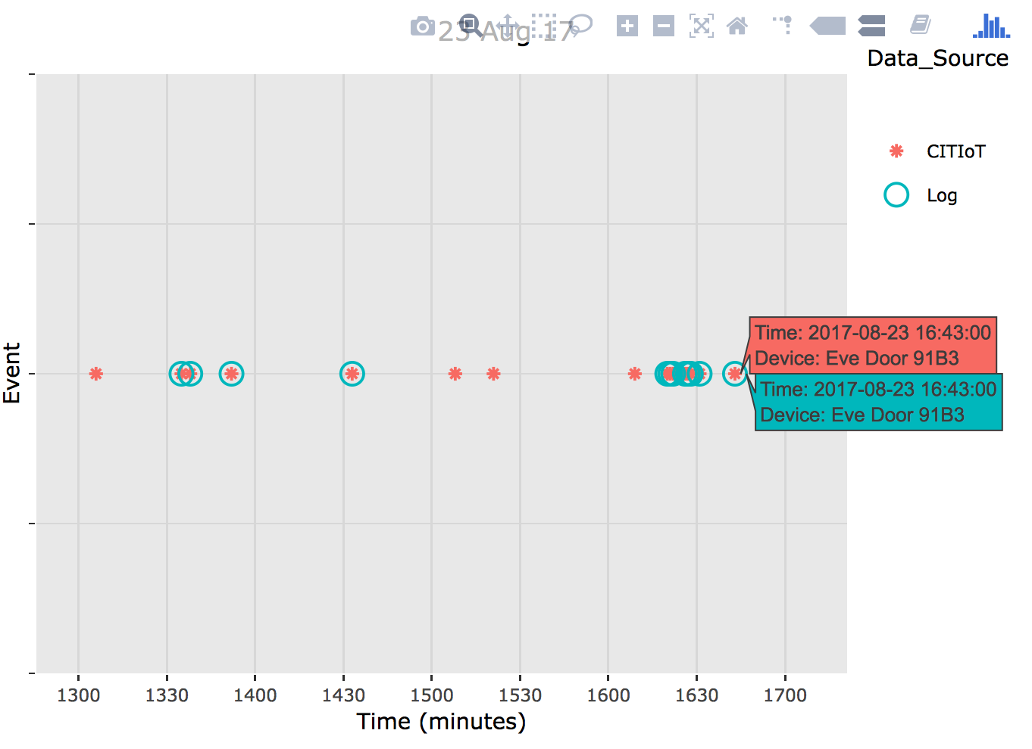
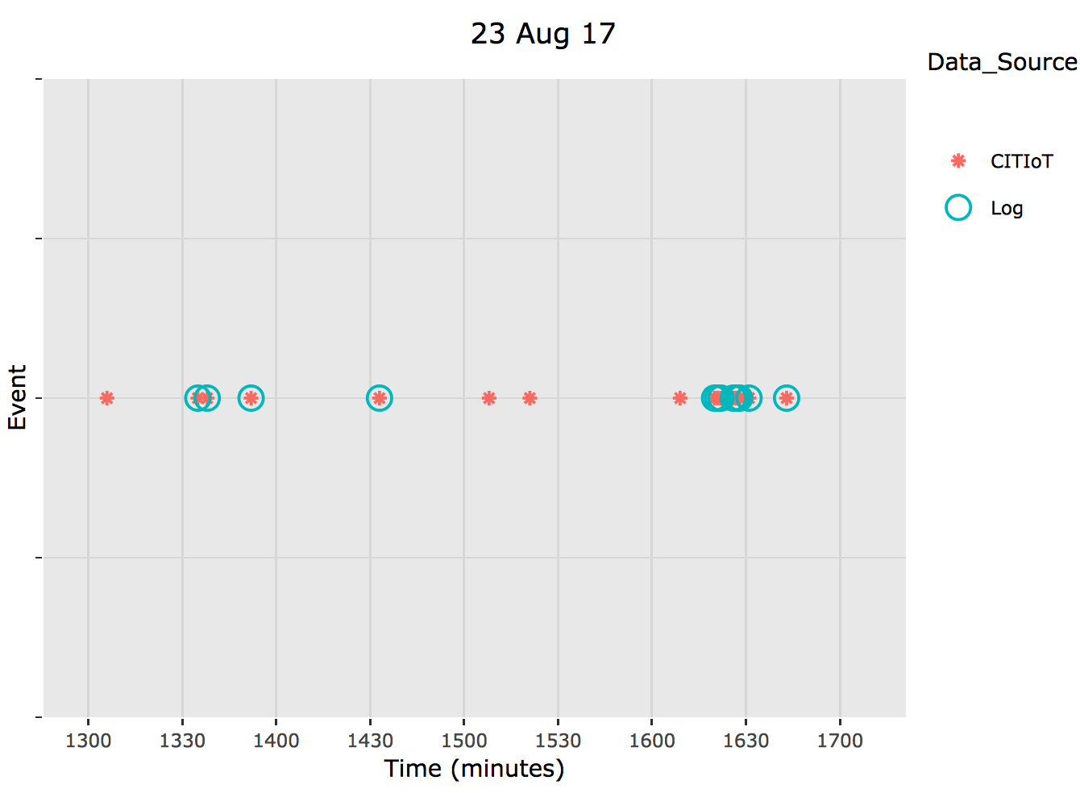

Slide 29
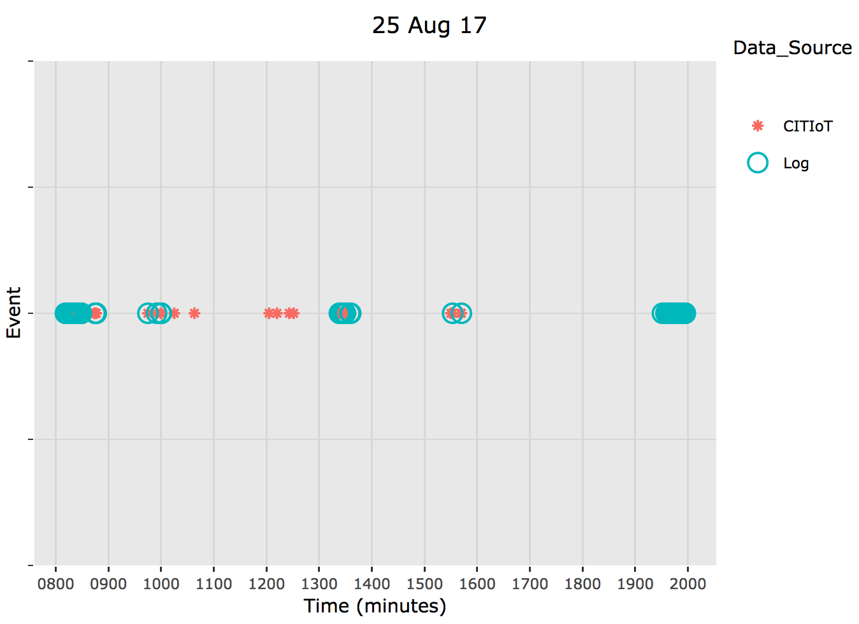
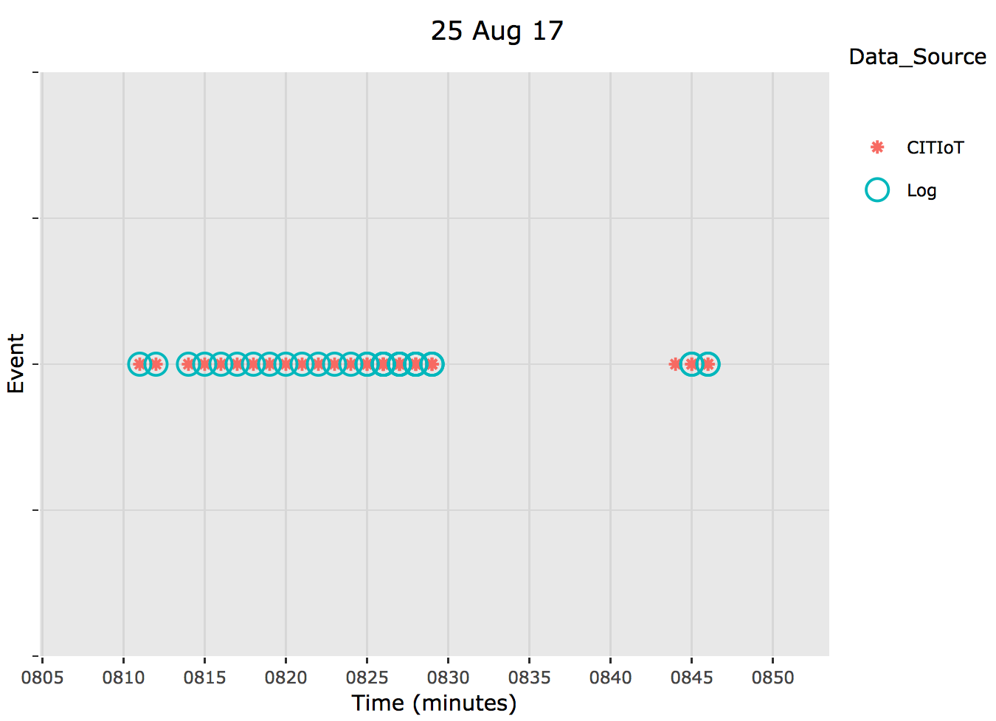

Slide 30
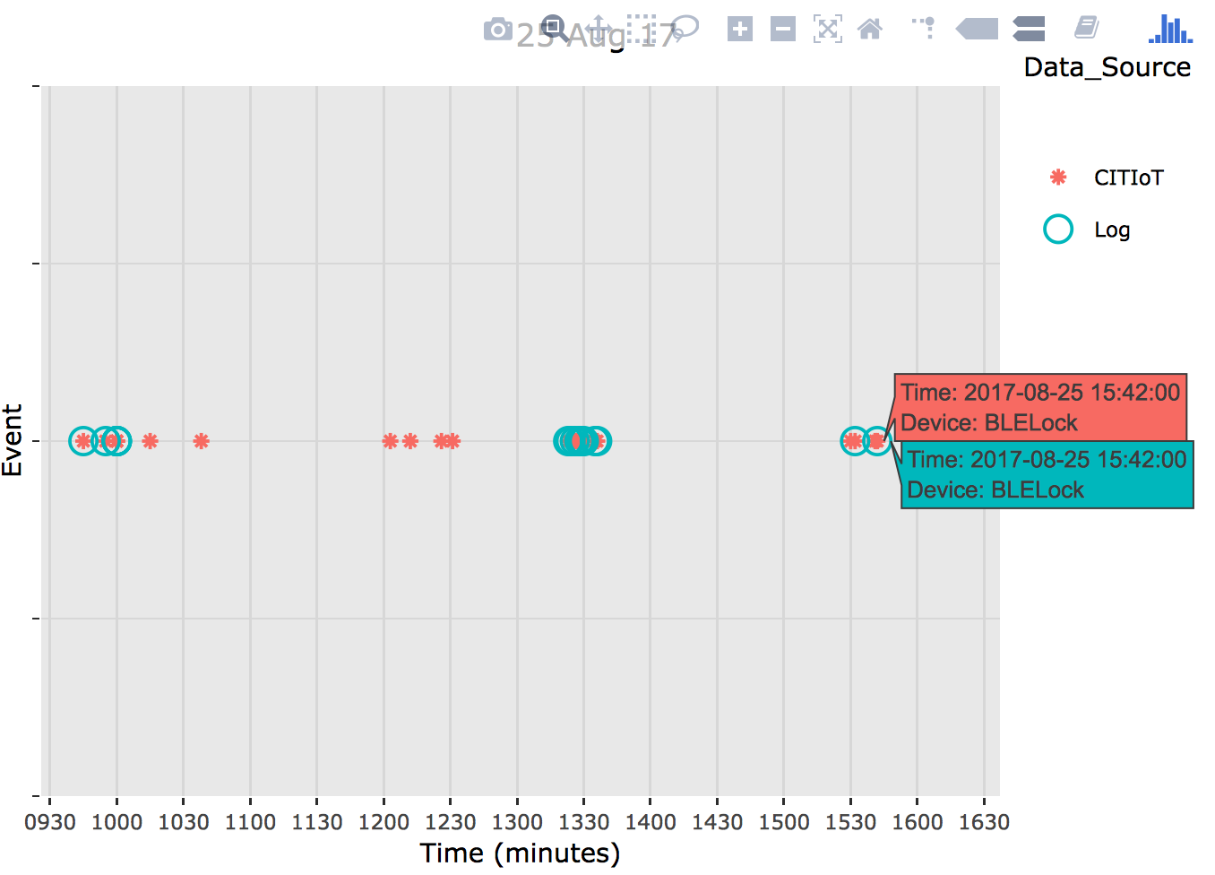
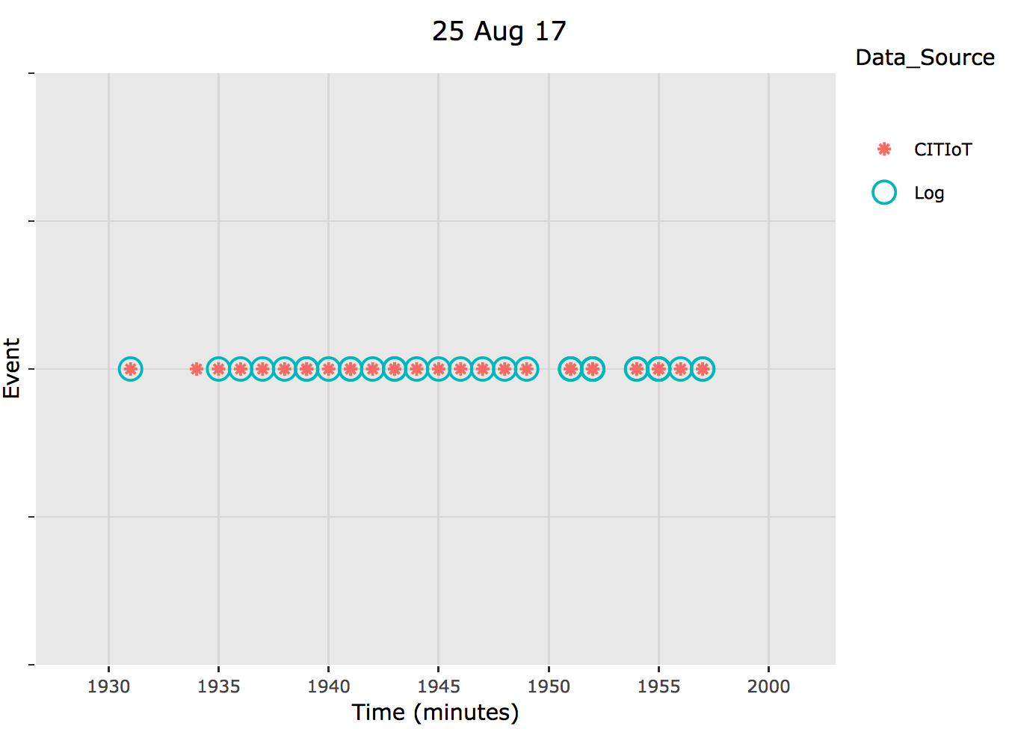
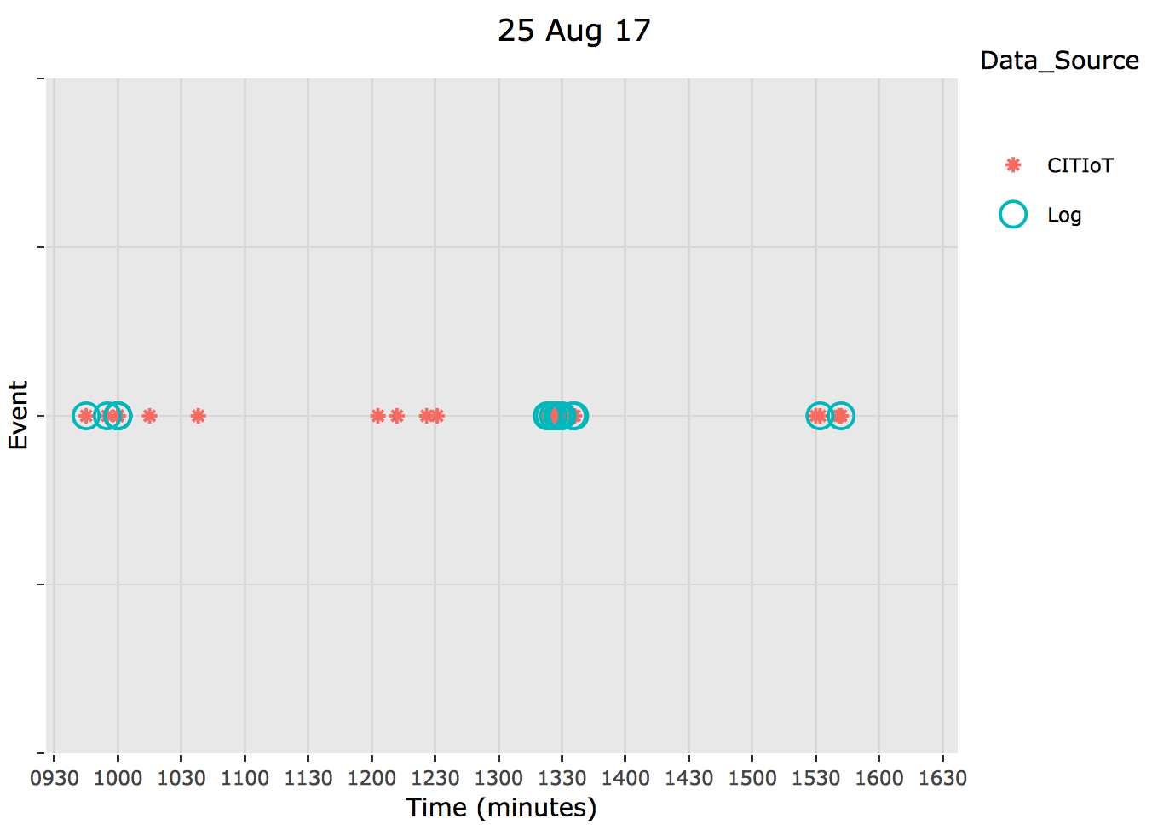

Slide 31
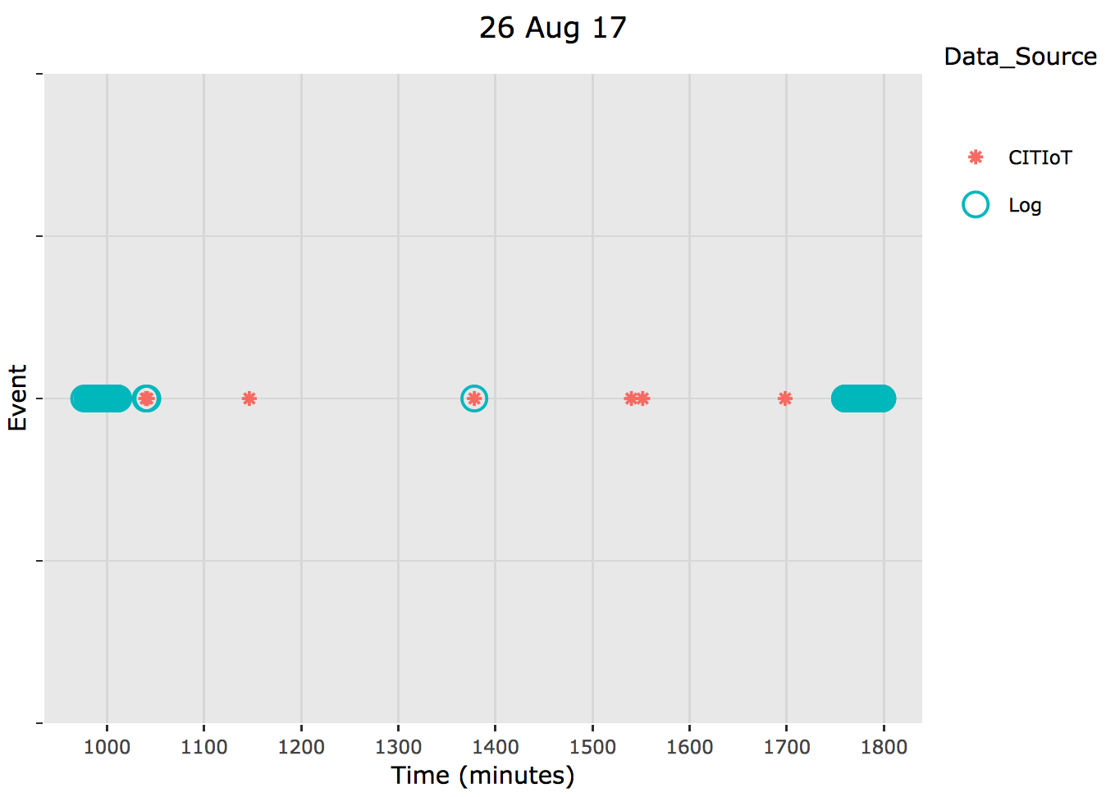
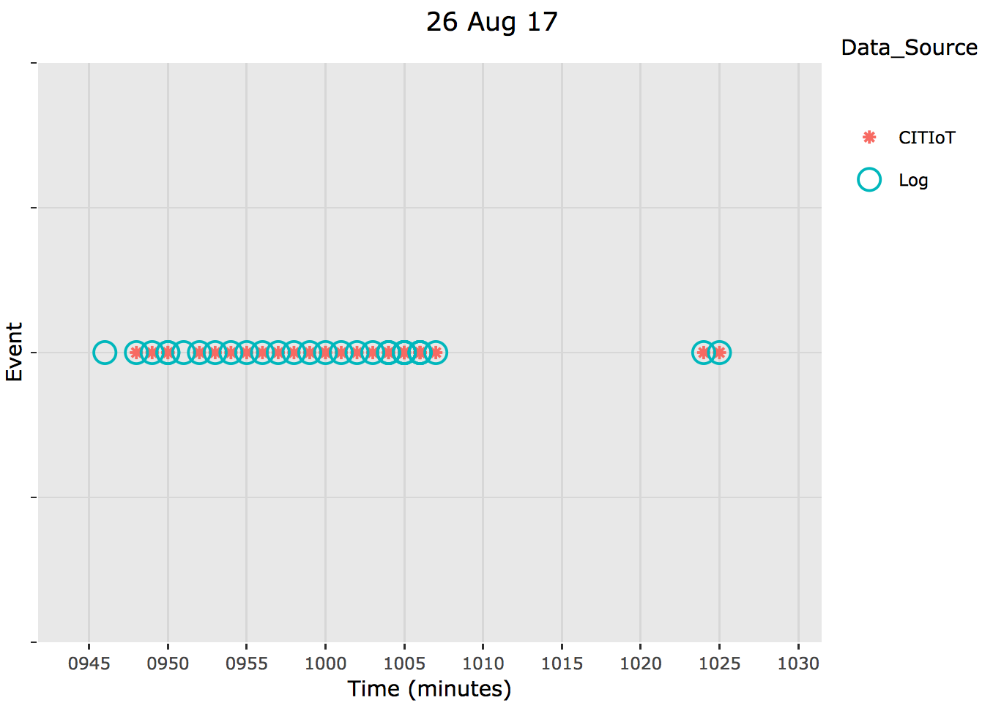

Slide 32
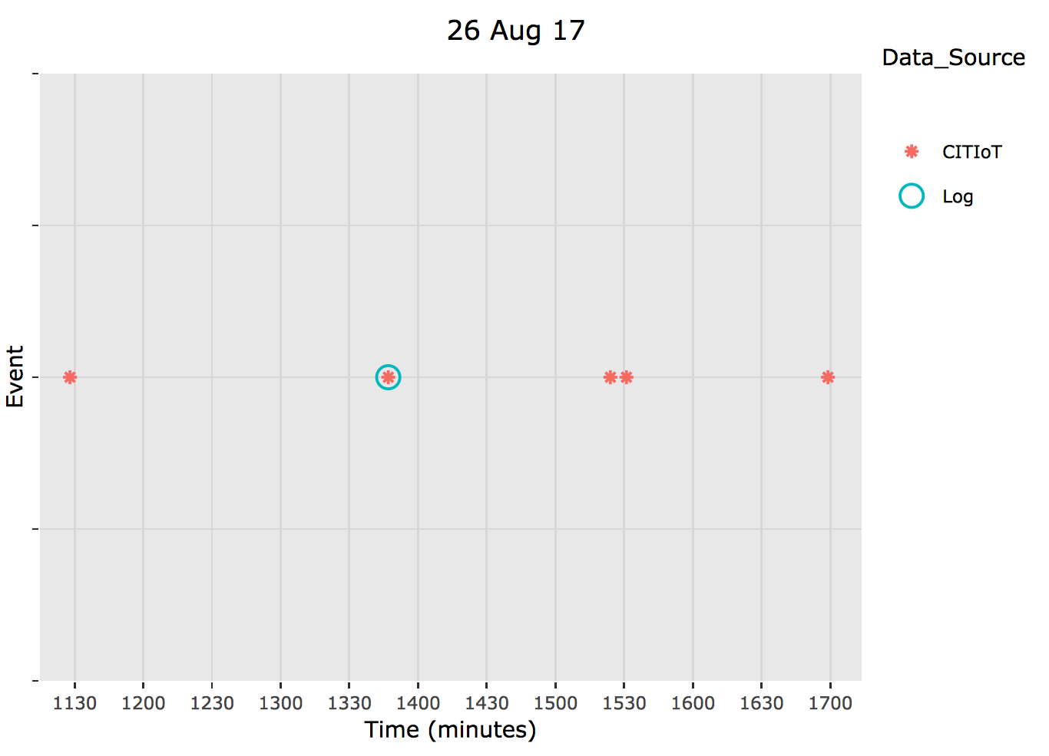
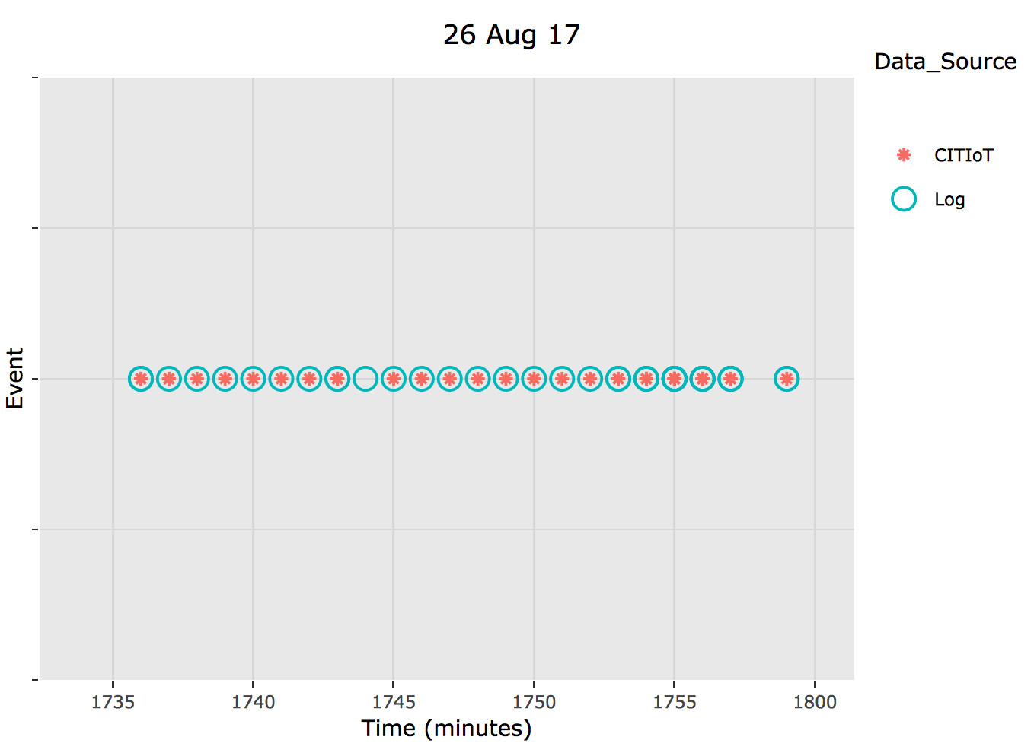
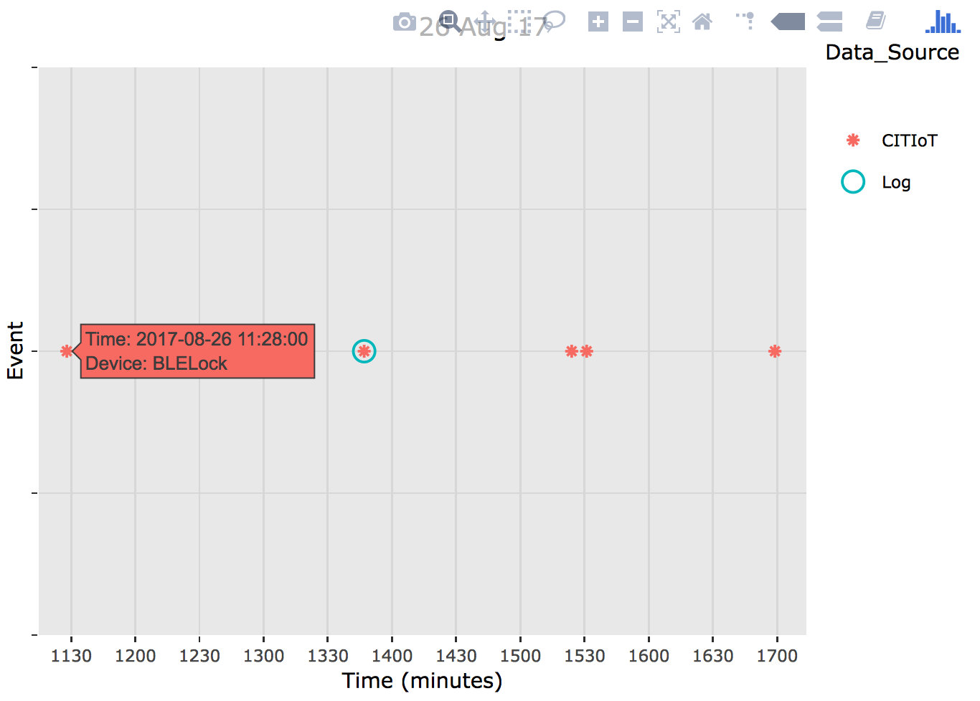

Slide 33
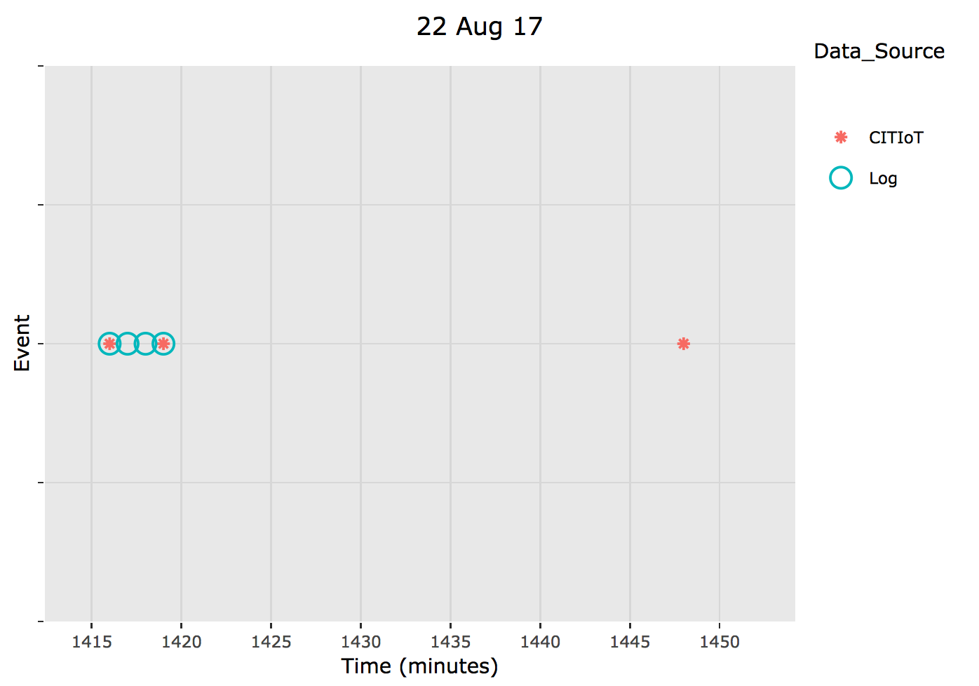
False Negative
False Positive
True Positive

Slide 34
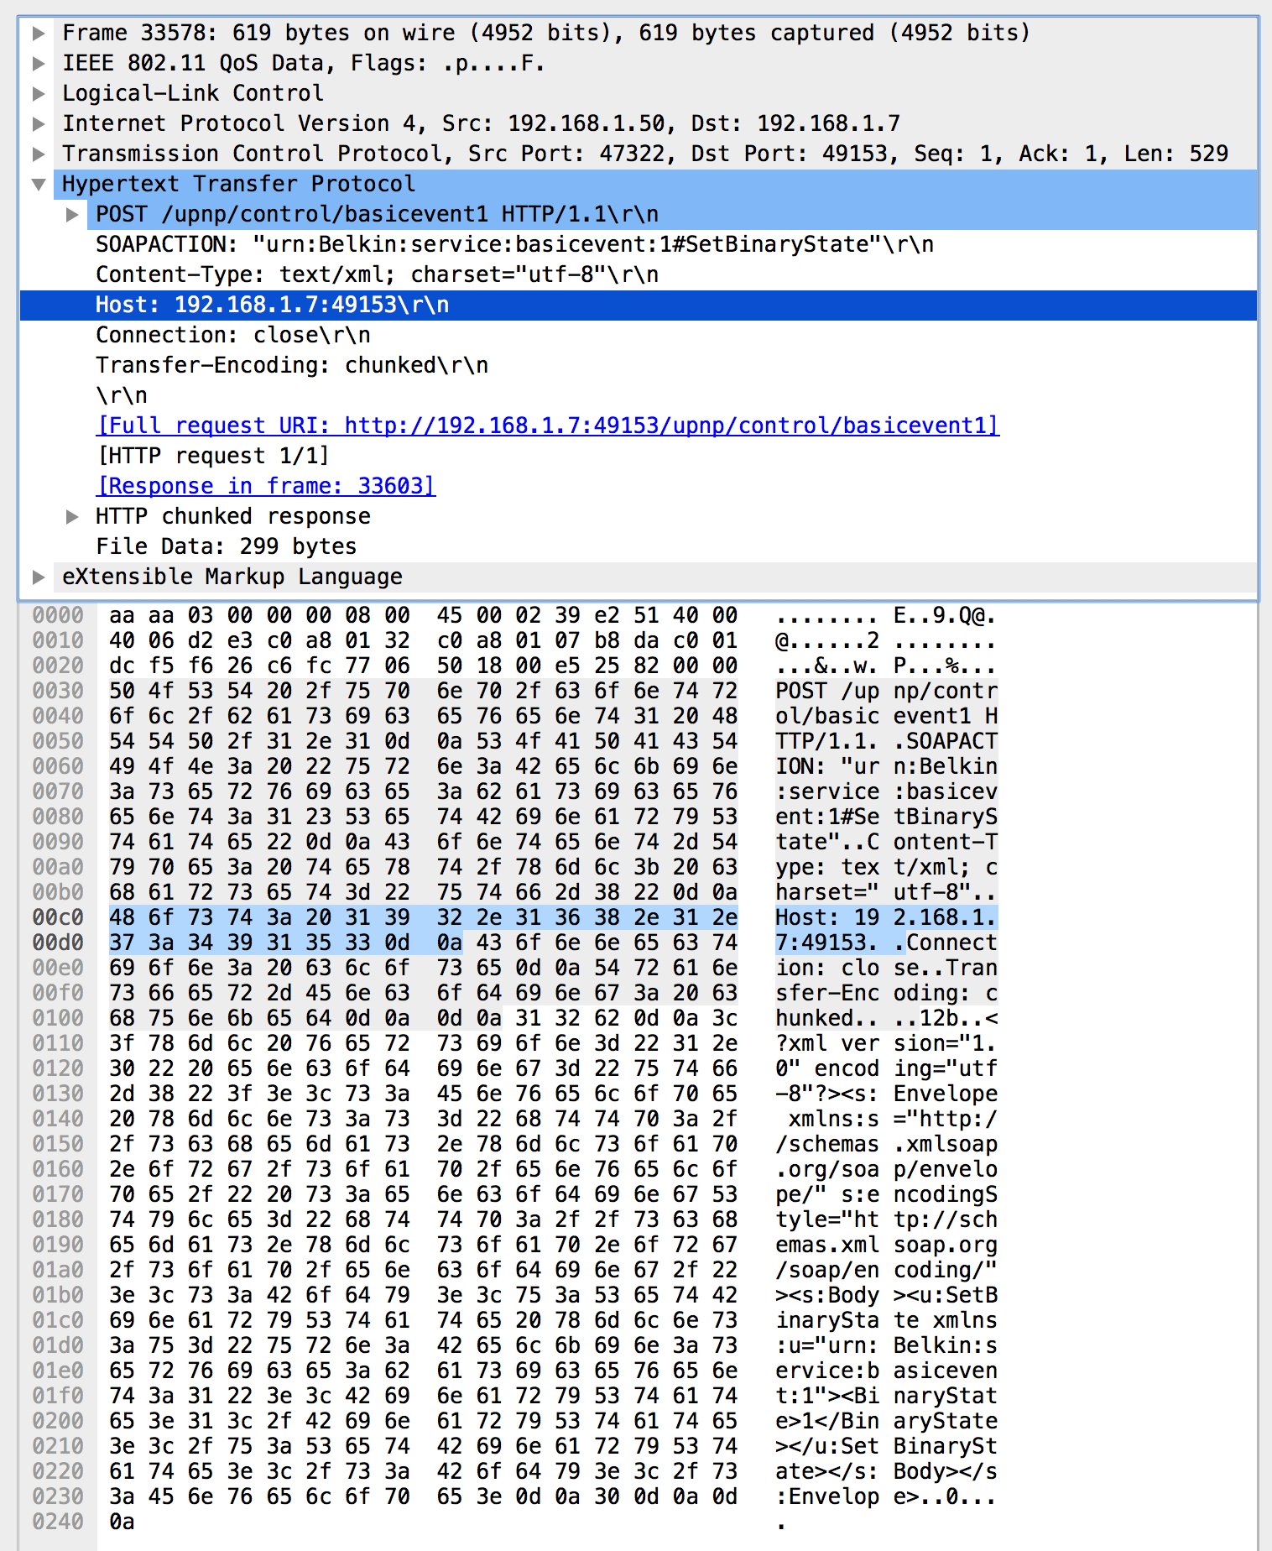
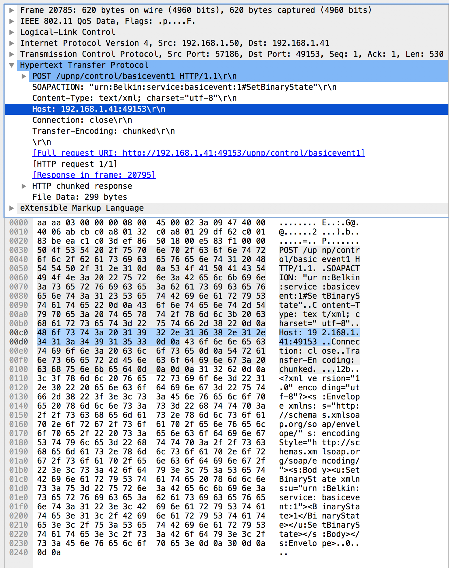
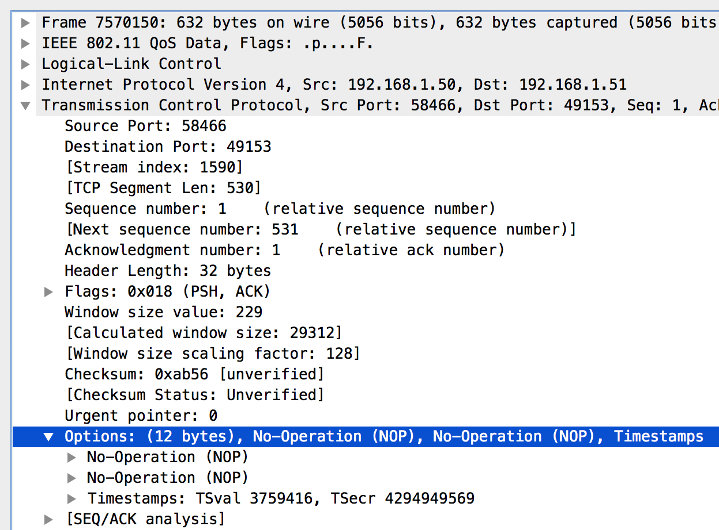

Slide 36
